Slide 1
Driver Fatigue Detection Method Based on Eye States With Pupil and Iris Segmentation
Technical Seminar
by
Manthana H K
231058012
Big Data Analytics
Under the guidance of
Panel Member 1: | Panel Member 2:
Arockiaraj S | Prathviraj N
Assistant Professor | Associate Professor
Manipal School of Information Sciences | Manipal School of Information Sciences
MAHE, Manipal | MAHE, Manipal

Slide 2
Presentation Outline
Introduction
2. Objectives
3. Literature Survey
4. Description
5. Image Dataset
6. Results
7. Conclusion
References

Slide 3
1. Introduction
In the 2018 Global Road Safety Status Report, World Health Organization (WHO) noted that 1.35 million people died in road traffic accidents every year.
According to the different fatigue performances, there are the following three kinds of detection methods:
Fatigue detection method based on the physiological signals.
Fatigue detection method based on the vehicle behavior.
Fatigue detection method based on the drivers’ facial features.

Slide 4
2. Objectives
Objectives of the work
• To obtain the eye image from the real time video.
• To extract the iris and pupil features from the eye image
• To calculate the Eye Aspect Ratio (EAR) for each of the eye image.
• To calculate the PERCLOS for each of the eye image.
• To classify the driver as fatigue and alerting the driver based on the real time
PERCLOS value.

Slide 5
3. Literature Review
Authors and Title | Dataset | Purpose of Study | Key Findings
“Real Time Driver Fatigue Detection System
Based on Multi-Task ConNN”
BURCU KIR SAVAŞ and YAŞAR BECERİKLİ
Year-2019
-YawDD VIDEO DATASET
-NTHU-DDD DATASET
The Dlib algorithm is used to accurately identify the driver’s eye and mouth information.
The proposed system can model the interactive
relationship between eye, mouth and sub-states.
“Real-Time Driver-Drowsiness Detection System Using Facial Features”
WANGHUA DENG and RUOXUE WU
Year-2019
-CelebA
-YawDD
Proposed a non-contact method called DriCare to detect the level of the driver’s fatigue.
Proposed the MC-KCF
algorithm to track the driver’s face using CNN and MTCNN to improve the original KCF algorithm.
“Driver Fatigue Detection Method Based on
Eye States With Pupil and Iris Segmentation”
QIANYANG ZHUANG and ZHANG KEHUA
Year-2020
-NTHU-DDD DATASET
The degree of the eye openness is successfully estimated by the proposed
SESDM network.
Image Segmentation is used extract the features of Iris nad Pupil.

Slide 6
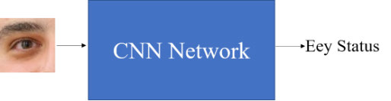
4. Description
PERCLOS :
(Percentage of Eyelid Closure Over Pupil)
is an effective indicator for fatigue
detection.
In order to accurately calculate PERCLOS,
we must judge the eye status in real time.
Images are directly taken as the input, and
then the CNN is used to judge to the
eye status.
General framework for eye status detection

Slide 7
4. Description
Fatigue Detection Framework
FIRST STAGE: Selection of eye image, from DLIB package.
SECOND STAGE: Degree of eye openesss is detected using SESDM.
THIRD STAGE: Calculate the PERCLOS value based on the level of eye
openness.

Slide 8
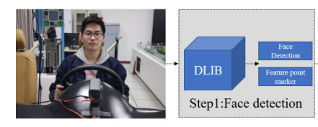
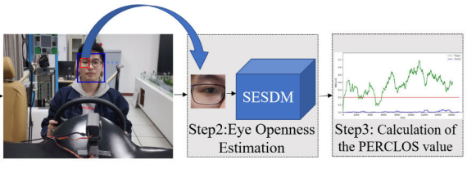
4. Description
Fatigue Detection Framework

Slide 9
4. Description
SESDM
The model consists of a segmentation network and a decision network.
The segmentation network performs pixel-level classification of eye images, which can accurately extract pupil and iris features from the video’s images.
Then the prior features and the original images are input into the decision network, which determine the level of eye openness.
It not only improves the accuracy of the network, but also improves the generalization of the network.

Slide 10
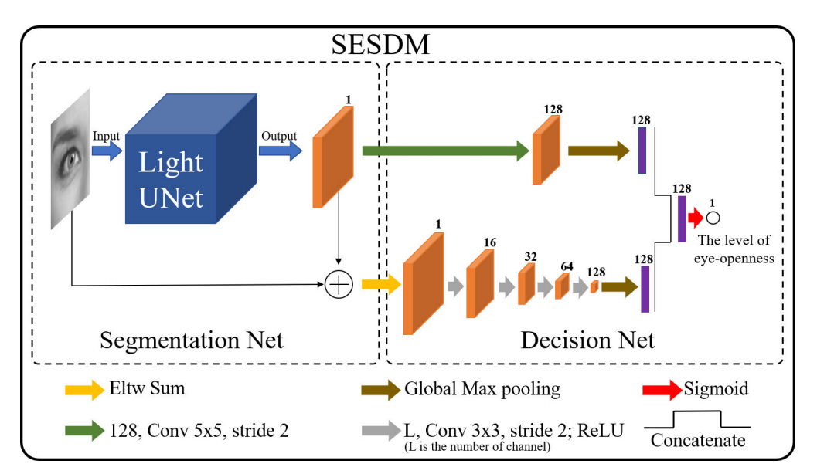
4. Description
Work Flow of the proposed Method

Slide 11
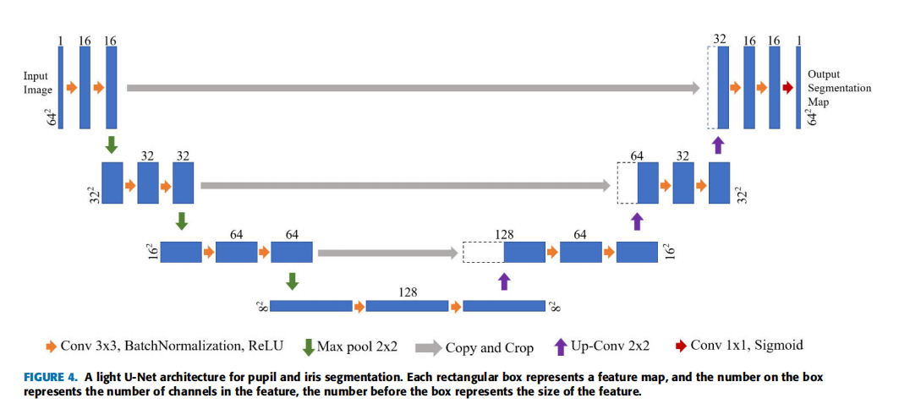
4. Description
A light U-Net architecture for pupil and iris segmentation

Slide 12
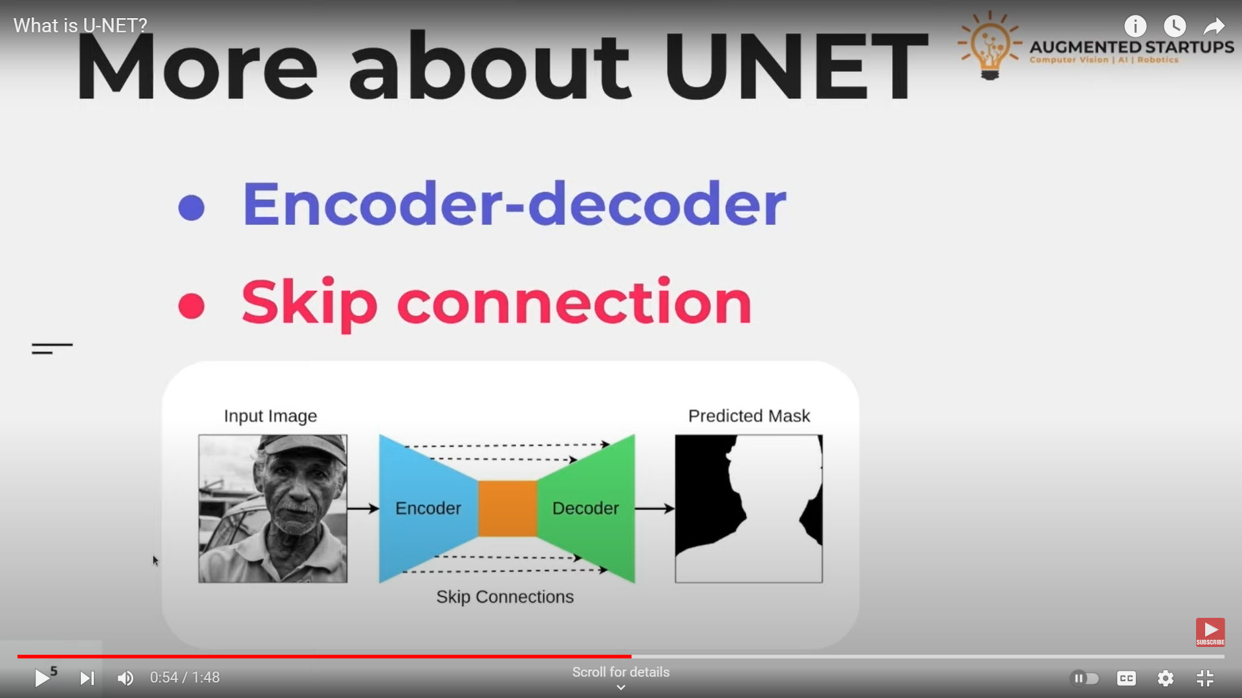
Image Segmentation using U-Net

Slide 13
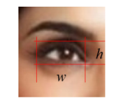
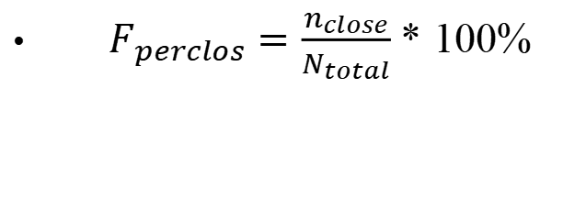
4. Description
Fatigue Parameter
Eye aspect ratio (EAR):
It is used to estimate eye openness.
For a fully opened eye, the eyeopenness level calculated by EAR is around 0.5 and 80% of the eyelid closure corresponds to EAR = 0.1.
PERCLOS calculates the proportion of time within a specified time duration that the eyelid covers over 80% of the pupil.
$F_{perclos}=\frac{n_{close}}{N_{total}}$ * 100%

Slide 14
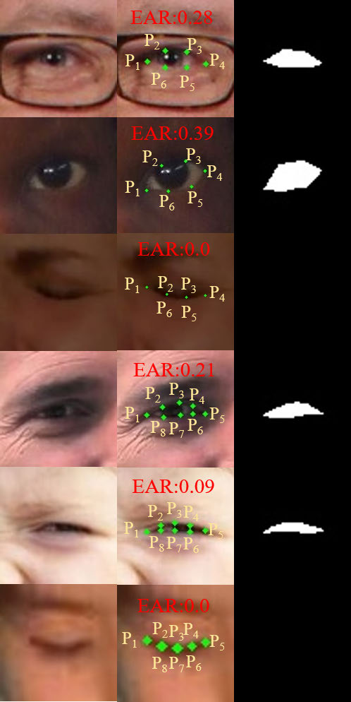


5. Dataset
Status of the eye:
Maps of the pupil and iris, as shown in Fig are
used to calculate the level of eye openness
through formula:
The production process of Eye Data
Eye Image Segmentation

Slide 15
5. Dataset
The NTHU-DDD dataset was a dataset developed by National Tsing Hua University, which was used at the Asian Conference on Computer Vision Workshop on Driver Drowsiness Detection.
The entire dataset contains 36 subjects of different ethnicities.
The dataset contained a lot of normal, drowsy, talking, and yawn face data in various scenarios.
4 scenarios from the NTHU-DDD dataset: BareFace, Glass, Night-BareFace and Night-Glasses.
The total number of videos is 213. Randomly divide the training set, validation set and test set according to the ratio of 4:1:4.

Slide 16
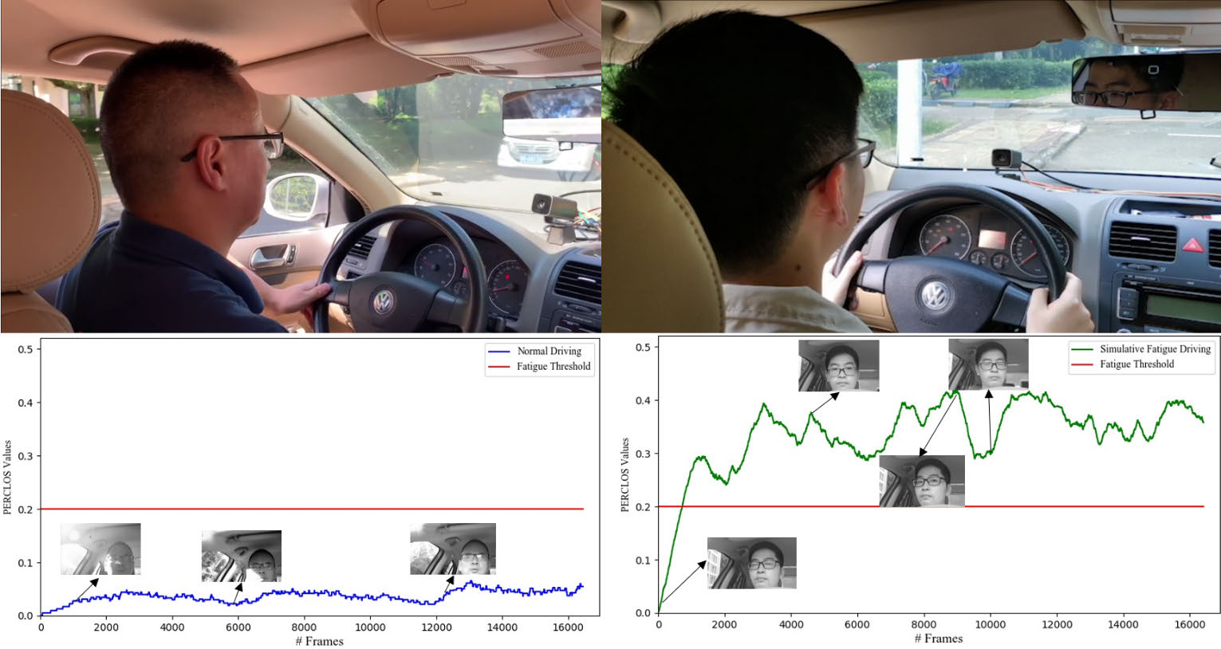
6. Result
The experiment scene and PERCLOS curve

Slide 17
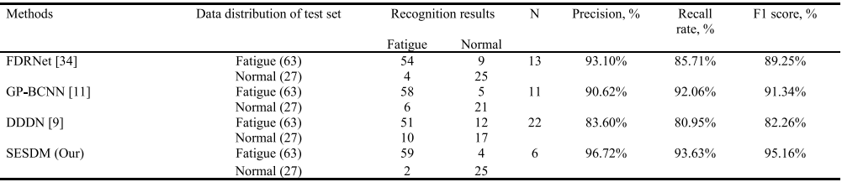
6. Result
Comparison of fatigue detection performance between different models on NHUT-DDD test set.

Slide 18
7. Conclusion
A novel fatigue detection method based on the measure of eye openness has been presented, which consists of the two steps including pupil/iris segmentation and fatigue classification.
This two-step model has better performances than an end-to-end fatigue detection because there are many features focusing on the pupil and iris.
PERCLOS value on the continuous detection of eye openness is computed to predict driver’s state, i.e., normal or fatigue driving state.

Slide 19
References
[1] P. Viola and M. Jones, ‘‘Robust real-time object detection,’’ Int. J. Comput. Vis., vol. 4, no. 4, pp. 34–47, 2001.
[2] C. Sagonas, G. Tzimiropoulos, S. Zafeiriou, and M. Pantic, ‘‘300 faces inthe-Wild challenge: The fifirst facial landmark localization challenge,’’ in Proc. IEEE Int. Conf. Comput. Vis. Workshops, Dec. 2013, pp. 397–403.
[3] C. Sagonas, G. Tzimiropoulos, S. Zafeiriou, and M. Pantic, ‘‘A semiautomatic methodology for facial landmark annotation,’’ in Proc. IEEE Conf. Comput. Vis. Pattern Recognit. Workshops, Jun. 2013, pp. 896–903.
[4] C. Sagonas, E. Antonakos, G. Tzimiropoulos, S. Zafeiriou, and M. Pantic, ‘‘300 faces in the-wild challenge: Database and results,’’ Image Vis. Comput., vol. 47, pp. 3–18, Mar. 2016.
[5] B. Reddy, Y.-H. Kim, S. Yun, C. Seo, and J. Jang, ‘‘Real-time driver drowsiness detection for embedded system using model compression of deep neural networks,’’ in Proc. IEEE Conf. Comput. Vis. Pattern Recognit. Workshops (CVPRW), Jul. 2017, pp. 438–445.

Slide 20
Queries
&
Suggestions

Slide 21
THANK YOU…

